Slide 1

Financial Literacy: The More You Know
By: Valencia Gooch

Slide 2
DATA WHY
Financial literacy is something that I believe should be at the root of the education system as something that is openly discussed and openly taught.
This project will investigate the Tennessee high school curriculum graduation requirement courses and individual financial literacy courses offered at county and school level.
The goal of the analysis will be to find areas where financial literacy courses could be implemented and highlight any trends or stories the data may provide.

Slide 3

DATA KNOW
TENNESSEE GRADUATION REQUIRMENTS
Total Required Credits: 22
Math: 4 credits (Students must be enrolled in a mathematics course each school year.)
English: 4 credits
Science: 3 credits, including Biology, Chemistry or Physics, and a third lab course
Social Studies: 3 credits, including U.S. History and Geography, World History and Geography, U.S. Government and Civics, and Economics
Physical Education and Wellness: 1.5 credits
Personal Finance: 0.5 credits (Three years of JROTC may be substituted for one-half unit of Personal Finance if the JROTC instructor attends the Personal Finance training.)
Foreign Language: 2 credits
Fine Arts: 1 credit
Elective Focus: 3 credits consisting of Math and Science, Career and Technical Education, Fine Arts, Humanities, Advanced Placement (AP) or International Baccalaureate (IB)

Slide 4
KEY CONSIDERATIONS
Tennessee has an average household size of 2.53.
The national poverty level for a 3-person household is $21,960.
Beginning with the graduating class of 2013, Tennessee first implemented the requirement of 0.5 credit of Personal Finance for graduation.
Since 2015, Tennessee has been one of the top 10 states with the highest rate of personal bankruptcy filings
Shelby County has been the top county in personal bankruptcy filings for the last two years.

Slide 5
DATA QUESTION
What areas in Tennessee should be targeted for adding additional financial literacy courses to its high school curriculum?

Slide 6

DATA ANALYSIS

Slide 7
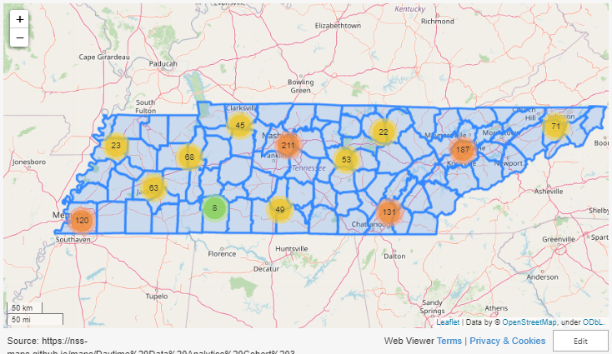
Tennessee
1063
High Schools
418
Public Schools
342
Private Schools

Slide 8
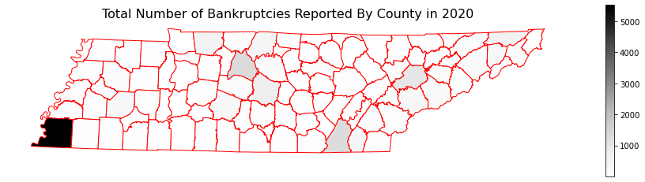
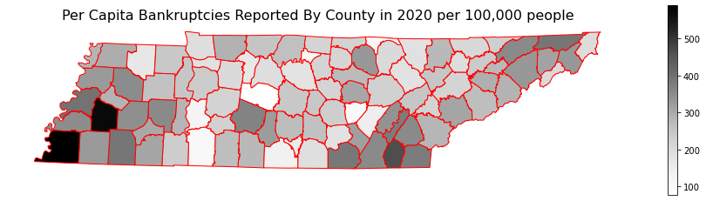
Bankruptcy
In 2020 Tennessee was atop the list for highest bankruptcies filed.
Before normalizing the data for population size, you can see that counties like Davidson, Shelby, Hamilton, and Knox have the highest personal bankruptcy filings largely due to population size.
When the data is normalized for population, we see a shift. We still see Shelby county, but we also see counties like Hardeman, Lauderdale, Haywood, and Bradley.
Shelby county had 589.93
Notes:
Lauderdale had 396.32, Hardeman had 393.04, Haywood had 573.11

Slide 9
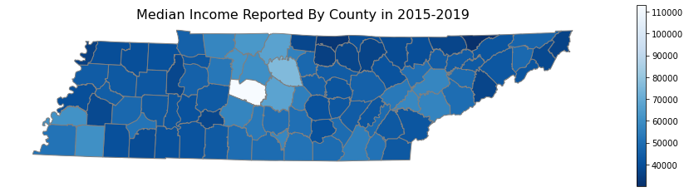
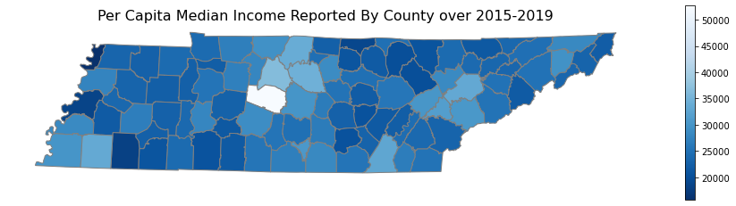
Income
When looking at income I looked at medians over a 5-year spread to account for any skewed data in years from the census.
When normalizing the data for population size there was a slight change in those counties with the lowest Median Household income.
Counties like Lake, Hardeman, Lauderdale, Clay, and Morgan county not only have the lowest median household income for the state, but all those counties have a median household income that falls below the national poverty level for average sized Tennessee household at $21,960. (2015-2019)
Notes:
Lake at 15732, Hardeman at 18172, Lauderdale at 18515, Clay at 18983, and Fentress at 20093. Interesting enough the 12.63% of counties in TN fall below that line.

Slide 10
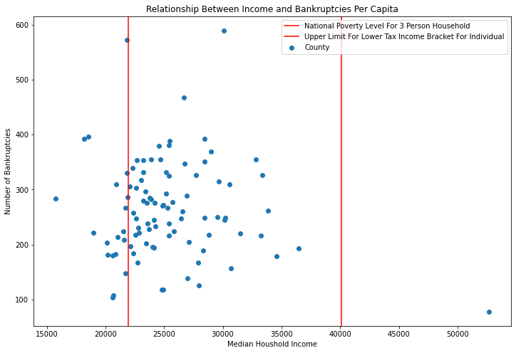
Income Vs. Bankruptcy

Slide 11
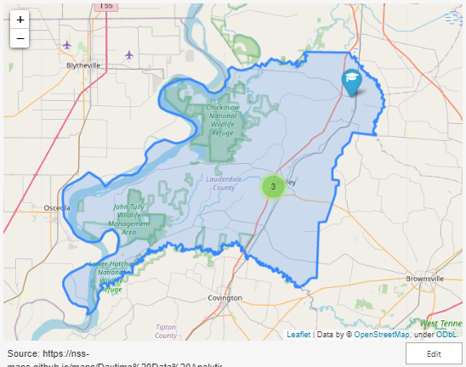
Lauderdale County
2
Public Schools
2
Private Schools

Slide 12
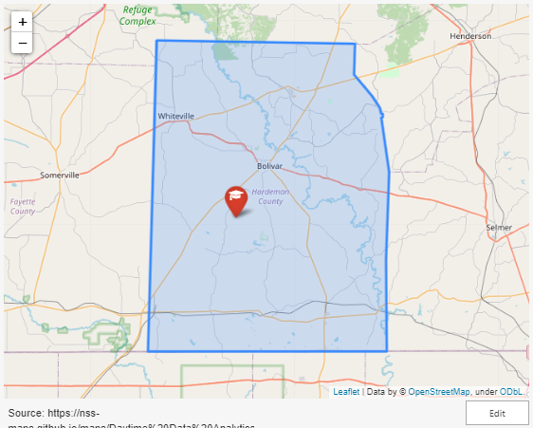
Hardeman County
0
Public Schools
1
Private Schools

Slide 13
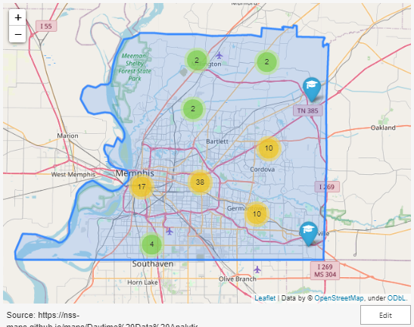
Shelby County
45
Public Schools
42
Private Schools

Slide 14

KEY INSIGHTS

Slide 15
FINDINGS
It would be beneficial to target areas with low household median incomes and high rates of bankruptcy fillings, especially since historical data shows those filling bankruptcy usually have lower annual income
Implementing financial literacy programs in high schools that extend past the required 0.5 credits would be most beneficial in Hardeman, Lauderdale, and Shelby counties.
The recommended 10 schools include all schools from both Hardeman and Lauderdale counties, as these two rural areas have limited access to schools' students may attend. The remaining schools come from Shelby county because there would be an economic advantage to financial literacy for the county consistently at the top of highest rate of personal bankruptcy findings.

Slide 16
WHERE DO WE START?
Public Schools
County
Private Schools
Halls High School
Ripley High School
Melrose High School
Whitehaven High School
B T Washington High School
Northwest Prep Academy
Lauderdale County
Hardeman County
Shelby County
New Beginnings Christian Center
First Apostolic Academy
Truth Academy

Slide 17
SOURCES
https://www.tn.gov/
https://www.uscourts.gov/
https://www.census.gov/
https://www.ramseysolutions.com/
https://www.donorschose.org/
https://maps.googleapis.com/maps/api/geocode/

